Slide 1


Rise with Bank Statement 101
RISETPO.COM

Slide 2



Webinar Hosts
Page 02
Jenny Beck
Shaun Dennison
Director of Learning and Development
EVP Non-QM Lending
For External Use Only.
RISETPO.COM
Notes:
!

Slide 3

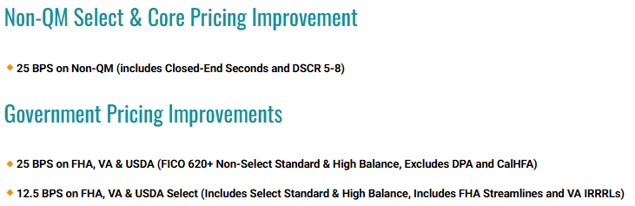

Page 06
Elevate your pipeline with august specials! Specials Available for loans locked August 1st – 31st, 2026
Closed-End Seconds Specials: eligible only in conjunction with RISETPO first liens. See our Closed-Ends Seconds matrix for details. Loans originated in US Territories and the following states are ineligible: MI NJ, NY, TN, TX, WV. Restrictions apply. Contact your account Executive for details. Important to note that a Closed-End Second Mortgage may typically have a higher interest rate than the first lien mortgage. August Special Offers valid for loans locked between 8/1/2026 and 8/31/2026. All offers are subject to change without prior notice. Rate and price improvements are applicable only to qualifying loan programs and borrowers, and not all applicants will qualify. Specials cannot be combined with any other offer or price exception unless explicitly stated. Terms, restrictions, and conditions apply. This is not a commitment to lend. Loans may qualify for additional price improvement with Select Specials as indicated on our Prime and Non-QM Rate sheets. RISE TPO is not affiliated with or acting on behalf of or at the direction of the Federal Housing Administration, Veterans Administration, or the Federal Government.
For External Use Only.
RISETPO.COM
RISETPO.COM

Slide 4

Page 04
Bank Statement 101 Discussion
For External Use Only.
RISETPO.COM

Slide 5
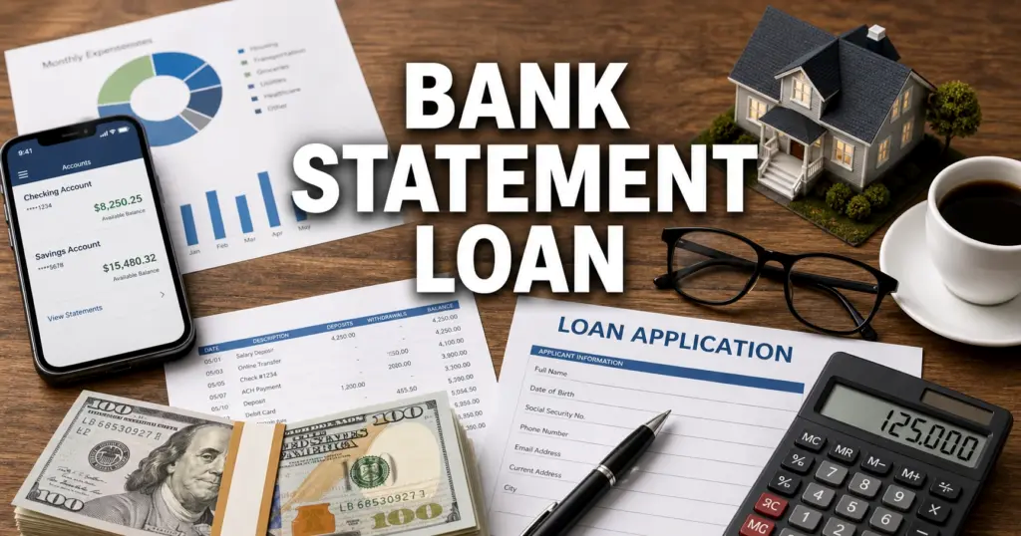
BANK STATEMENT 101: A BEGINNER’S GUIDE
For External Use Only.
RISETPO.COM
Notes:
Welcome everyone to today’s session, Bank Statement 101: A beginner's guide. I’m joined by Shaun Dennison, our guest expert, to walk through how experienced underwriters approach these files.
Whether you are a new underwriter, processor, or loan officer, bank statement loans can be one of the most challenging income types to analyze.
Today we’ll discuss how experienced underwriters approach these files, common pitfalls, and practical tips you can apply immediately.
We’ll also walk-through real-world scenarios and answer your questions!

Slide 6
UNDERSTANDING BANK STATEMENTS
Why Non-QM Borrowers use bank statements
Common borrower profiles
Personal vs. Business statements
Why tax returns don’t always tell the full story
What makes bank statement loans different from conventional income analysis?
For External Use Only.
RISETPO.COM
Notes:
Moderator:
What Makes Bank Statement loans different from conventional income analysis?
Moderator:
Let’s ask the audience,
What types of borrowers have you seen benefit most from bank statement programs?

Slide 7
ANALYZING BANK STATEMENTS
Read the Self-Employed business narrative
Verify all pages are included in submitted statements
Look for deposit consistency – Frequency and Amount
Identifying business income
Spotting transfers
Reviewing beginning and ending balances
When you receive 12 or 24 months of bank statements, where do you start?
For External Use Only.
RISETPO.COM
Notes:
Moderator:
When you receive 12 or 24 months of bank statements, where do you start?
Moderator:
Let’s ask the audience: What do you do first?
Borrower Name
Deposit History
Beginning/ending balances
Missing pages

Slide 8
CALCULATING QUALIFYING INCOME
Gross deposits
Eligible deposits
Business revenue
Expense factors
CPA letters
Average monthly income
What deposits count toward qualifying income?
For External Use Only.
RISETPO.COM
Notes:
Moderator:
What deposits count toward qualifying income:
Moderator:
What about this scenario:
A borrower deposits $35,000 a month into a business account, but a CPA verifies a 40% expense factor. How would you calculate the qualifying income?

Slide 9
COMMON MISTAKES
Counting transfers as income
Business on 1003 does not match business on bank statements
Using incomplete statements
No tax preparer due diligence (license verification)
Ignoring declining income
Not addressing deposit gaps/inconsistencies
Deposit verbiage vs industry
Income duplication – using personal and business statements
What are the most common mistakes you see newer underwriters make?
For External Use Only.
RISETPO.COM

Slide 10
RED FLAGS
Large unexplained deposits
Cash-heavy business deposits
NSFs
Transfers from personal accounts (owner re-funding business)
Altered statements (names, deposits and/or beginning and ending balances)
Round-dollar deposits
Negative daily ending balances
No online presence – can’t find the business
What makes you stop and investigate further?
For External Use Only.
RISETPO.COM

Slide 11
THE GOTCHA’S
Key word deposit disqualifiers
  Refund
  Loan
  Advance
  Draw
  Disbursement
  Transfer
Knowing exact employee count, time in business and ownership %
Monthly income vs Assets (reserves) not in line
Undisclosed debt payments in the “withdrawals”
Lack of Entity due diligence up front – i.e. Secretary of State shows entity “dissolved”
What are some of the issues that seem small but can derail a loan?
For External Use Only.
RISETPO.COM
Notes:
Moderator:
What are some issues that seem small but can derail a loan?
Moderator:
What about this scenario:
A borrower deposits $35,000 a month into a business account, but a CPA verifies a 40% expense factor. How would you calculate the qualifying income?

Slide 12
PERSONAL vs. BUSINESS STATEMENTS
Advantages
Challenges
Business expense factors
Co-mingled funds
Sole proprietors
When would you prefer one over the other?
For External Use Only.
RISETPO.COM
Notes:
Moderator:
When would you prefer one over the other?

Slide 13
DOCUMENTATION
Tax Preparer letter
P&L statement
Business License
Corporate Documents
Secretary of State
Website
Invoices
Detailed/Correct Self-Employed narrative – Tell the story
What documentation makes your job easier?
For External Use Only.
RISETPO.COM

Slide 14
FRAUD AWARENESS
What fraud indicators have you actually encountered?
Bank Statement calculation software – fraud detection
Bank statement alterations
  Misspellings
  Faunt variance
  “Math not mathing”
Fake websites
  Domain name – doesn’t match legitimate site
  Business in existence 5 years but domain registered 2 months ago
  Poor quality content
    Spelling errors
    Broken links
    Generic stock photos
For External Use Only.
RISETPO.COM

Slide 15
BEST PRACTICES
If you could give one piece of advice to a new underwriter, what would it be?
Follow the money
Trust but verify
Never assume
Document your thought process
Ask questions early
Review every page
For External Use Only.
RISETPO.COM

Slide 16

LIGHTNING ROUND Q&A…
For External Use Only.
RISETPO.COM
Notes:
Moderator asks quick questions:
Can gift funds be counted as income?
Would you count a tax refund?
What about loan proceeds?
Are transfers income?
What if statements are missing a page?
Can you use Zelle deposits?
What if the borrower mixes personal and business funds?
Can cash deposits be counted?
Does a CPA letter replace bank statements?
What is the biggest red flag you have ever seen?

Slide 17
CLOSING
What is one takeaway you will apply to your next bank statement loan?
For External Use Only.
RISETPO.COM
Notes:
Share final tips, then open the floor for audience questions.

Slide 18
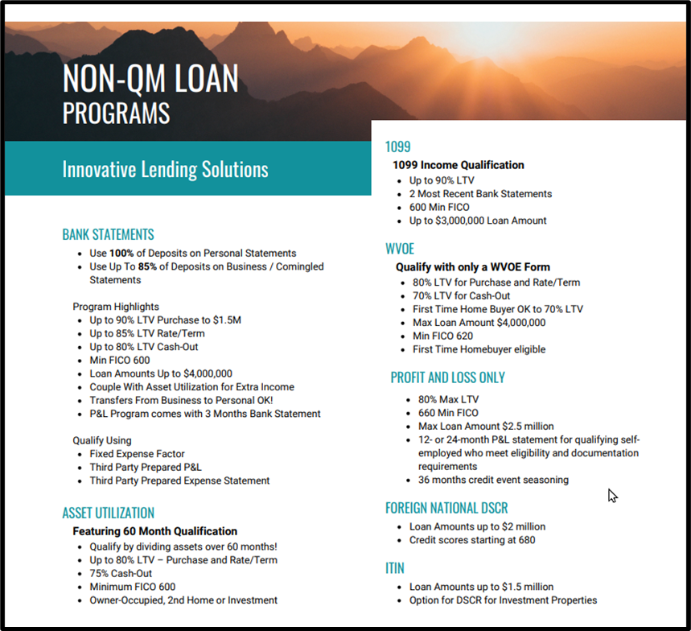
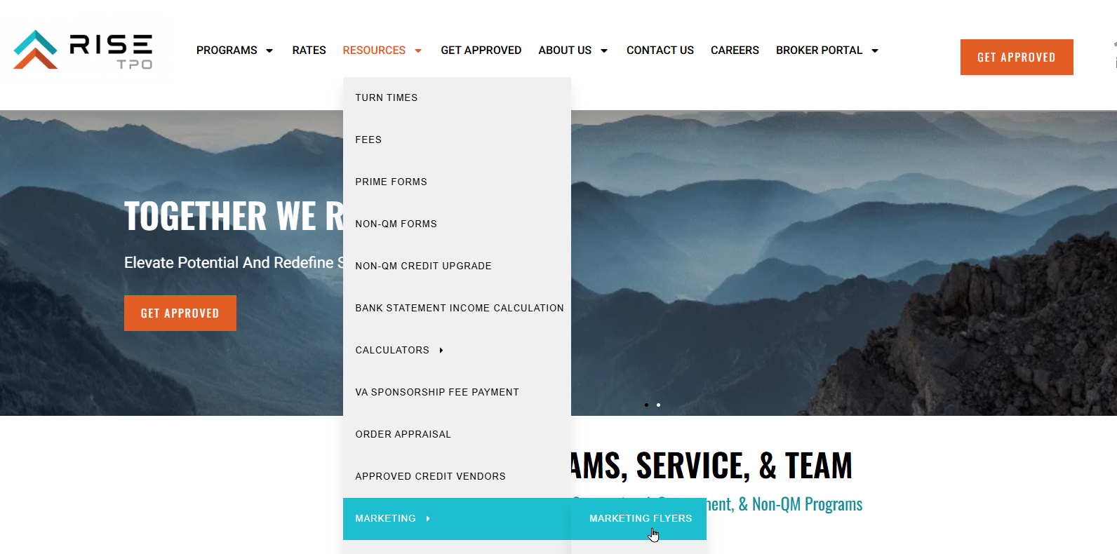
MARKETING AVAILABLE
For External Use Only.
RISETPO.COM

Slide 19

Page 15
QUESTIONS
For External Use Only.
RISETPO.COM

Slide 20
Page 16
THANK YOU
RISETPO.COM
866.328.8059
RISE TPO, 19000 MacArthur Blvd, Ste 200, Irvine, CA 92612 | Phone: 866.328.8059 | RISE TPO is a registered DBA of OCMBC, Inc. NMLS ID #2125. Programs and rates are subject to change without notice. Turn time estimates are not warranted or guaranteed. Intended for use by real estate and lending professionals only and not for distribution to consumers. OCMBC, Inc. is licensed in the following states that require specific licensing disclosures: AZ (#0909401). CA CFL - Loans made or arranged pursuant to the California Financing Law, Licensed by the Department of Financial Protection and Innovation under the California Residential Mortgage Lending Act (#4130724). GA Georgia Residential Mortgage Licensee (#20571). IL MB.6759942 Illinois Department of Financial and Professional Regulation, Division of Banking, 100 West Randolph, 9th Floor, Chicago, IL 60601 1-888-473-4858. MA Lender (#ML2125). MO Missouri Mortgage Company License #2125 In-State Office: Missouri In-State Branch License #2396190 3636 S. Geyer Road, Suite 100, Office 134, St. Louis, MO 63127. RI Rhode Island Licensed Lender. NJ Licensed by the N.J. Department of Banking and Insurance. VA NMLS ID #2125. Also licensed in AK, AL, AR, CO, CT, DC, DE, FL, HI, IA, ID, IN, KS, KY, LA, MD, ME, MI, MN, MS, MT, NC, ND, NE, NH, NM, NV, OH, OK, OR, PA, SC, SD, TN, TX, UT, VT, WA, WI, WV, and WY. Not licensed or conducting business in New York. For more licensing information, visit the Nationwide Multistate Licensing System’s Consumer Access website www.nmlsconsumeraccess.org. Copyright 2026.
For External Use Only.

